Slide 1
Understanding Sarcasm from Reddit texts using Supervised Algorithms
Presented By:
Abdullah Umar Nasib 19166009
Ashik Adnan 22166003
Nazifa Khanom 22166009
Fahim Hasnat 22166016
Md Mazidul Hasan 22166018
S M Mahsanul Islam Nirjhor 22166037

Slide 2
Introduction
Sarcasm is an interesting linguistic phenomenon in which a sarcastic individual’s intended meaning is contrary to the way it is communicated.
Sarcasm is employed to convey a meaning different from the literal one, usually in satirical context.
Sarcasm is utilized for humor as well as criticism of ideas, people or events
We want to perform sarcasm detection in text
No limit for the maximum characters.
text can be a sentence, a word or even a paragraph
Our proposed method uses a supervised approach to learn the sarcastic patterns from Reddit texts.

Slide 3
Literature Review
Verma et al. [5] reviews current findings on sarcasm detection, highlighting several solutions and issues. They compared the available models for detecting sarcasm in this study.
By using Sentiwordnet to calculate polarity scores, Adarsh et al. [9] tried to bring out the negativity in good comments while also bringing out the positives in negative phrases. They used the Term Frequency (TF)-Inverse Document Frequency (IDF) approach to transform text files into vector models based on the frequency of words in the text.
Using Reddit and Twitter data, Fiallos et al. [7] suggested a system for automatically categorizing data. A labeled dataset of 42,100 Reddit publications was used to train their model. The researchers next put their trained model to the test. For testing they used a dataset of tweets from 1,573 profiles, with an average of 100 tweets per user. They have a 75.62% accuracy rate during this process.

Slide 4
Models
Logistic Regression
Bidirectional LSTM
CNN

Slide 5
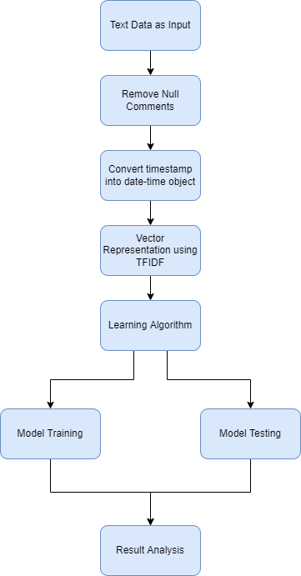
Proposed Model

Slide 6
Dataset Detail
In this paper, we utilize a dataset called “Sarcasm on Reddit” prepared by Dan Ofer from Kaggle. The data was originally gathered by Khodak, M. et al. for their article "A Large Self-Annotated Corpus for Sarcasm". In this data set there are 10,10,828 rows consisting of features including: “comment”, “author”, “subreddit”, “score”, “ups”, “downs”, “date”, “created-utc” and “parent-comment”. The dataset is labeled by a label column representing 1 as “sarcastic” and 0 as “non-sarcastic”.

Slide 7
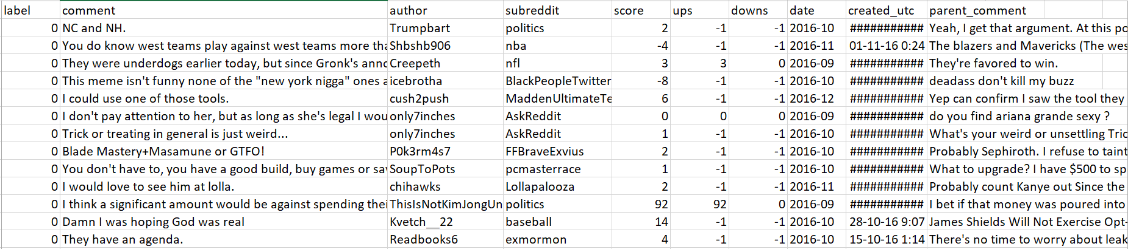
Dataset Detail

Slide 8
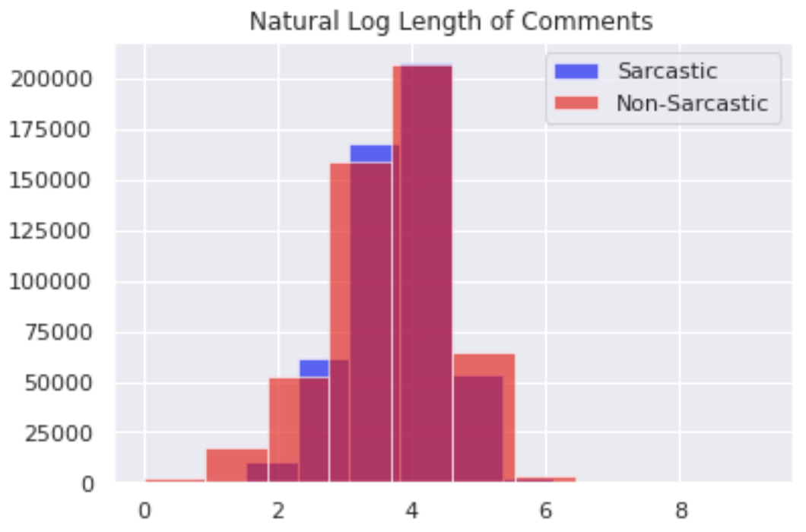
Natural Length of Comments

Slide 9
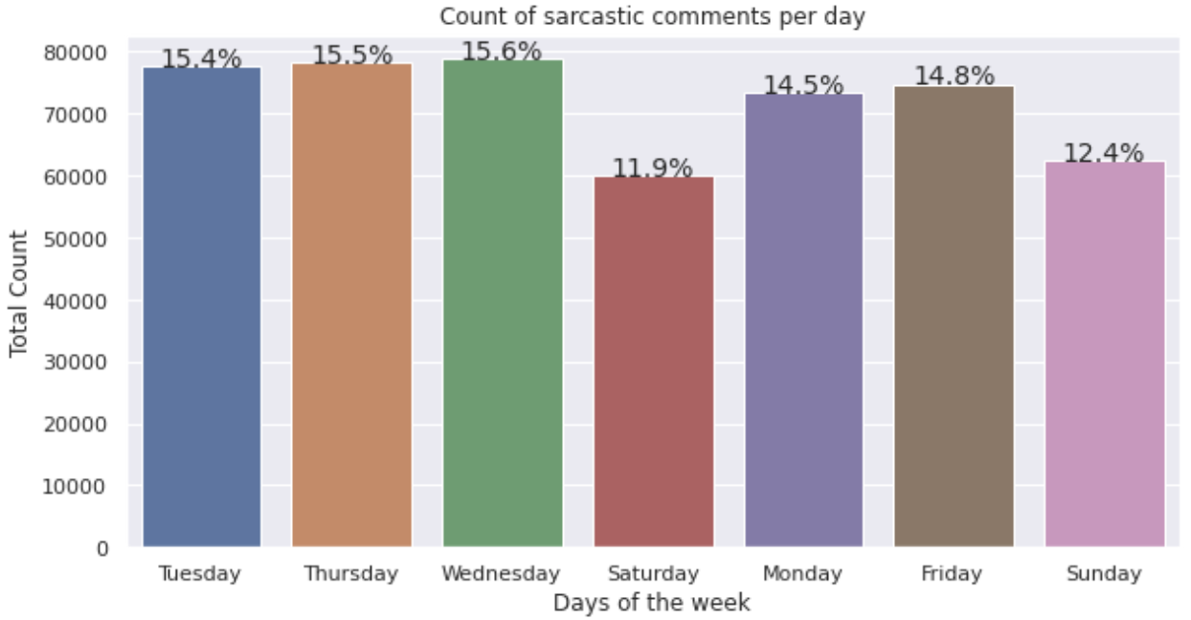
Sarcastic Comments Count per Day

Slide 10
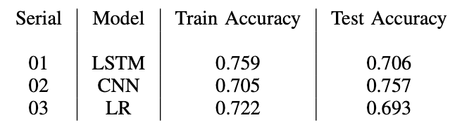
Experimental Result

Slide 11
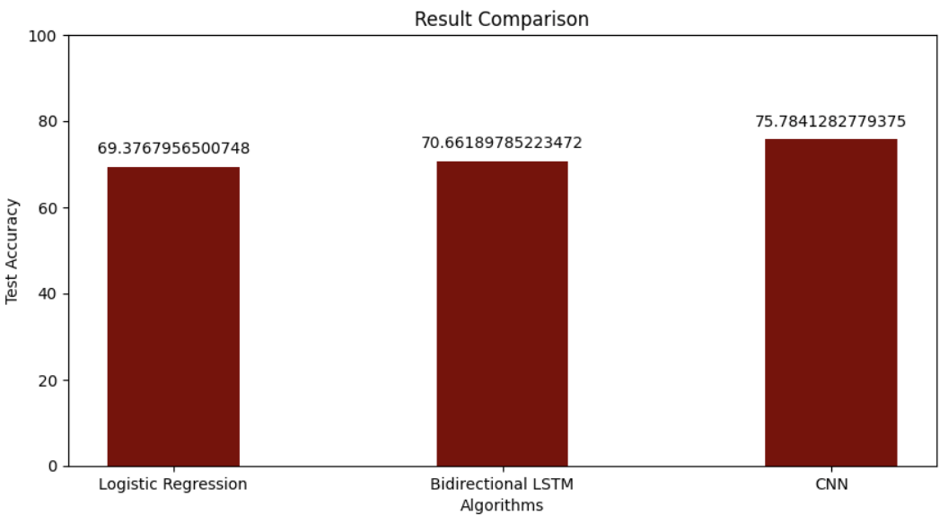
Result Comparison

Slide 12
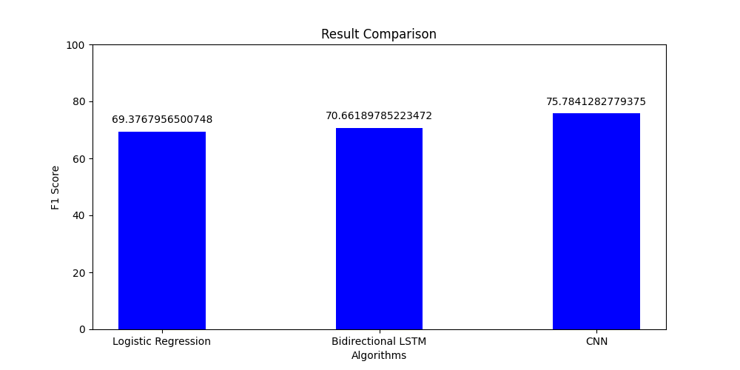
F1 Score Comparison

Slide 13
Conclusion
Achieved Accuracy of :
70% from Logistic Regression
71% from Bidirectional LSTM
76% from CNN

Slide 14
Future Work
Making more enriched dataset
Behavioral Modeling Framework
Semi - Supervised pattern extraction to extract implicit sentiment and hashtag-based supervision

Slide 15
Thank You !

